Slide 1
Chapter 26 Current and Resistance
Key contents
Ohm’s law
Power in electric circuits

Slide 2
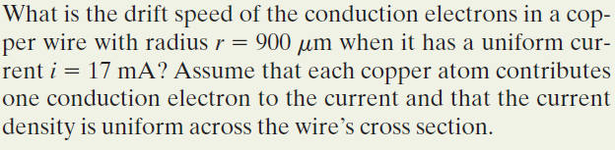
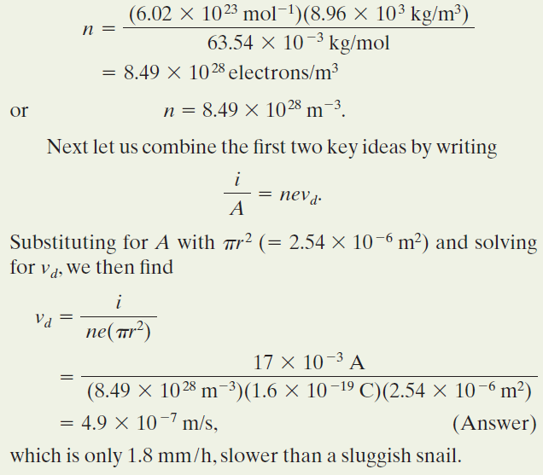
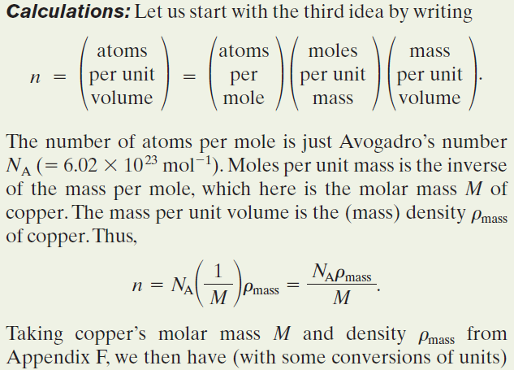

Example: In a current, the conduction electrons move very slowly.

Slide 3


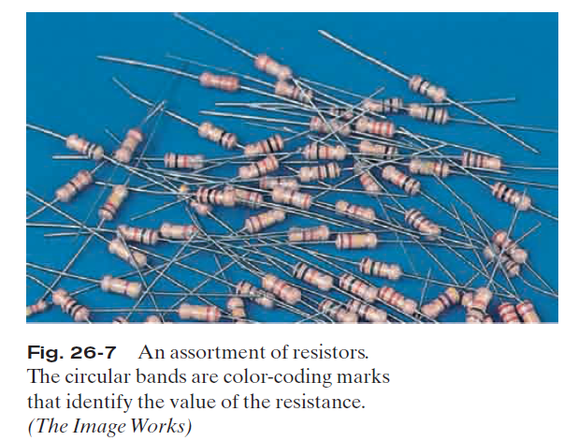
26.4: Resistance and Resistivity:
We determine the resistance between any two points of a conductor by applying a potential difference V between those points and measuring the current i that results. The resistance R is then
The SI unit for resistance that follows from Eq. 26-8 is the volt per ampere. This has a special name, the ohm (symbol Ω):
In a circuit diagram, we represent a resistor and a resistance with the symbol .

Slide 4
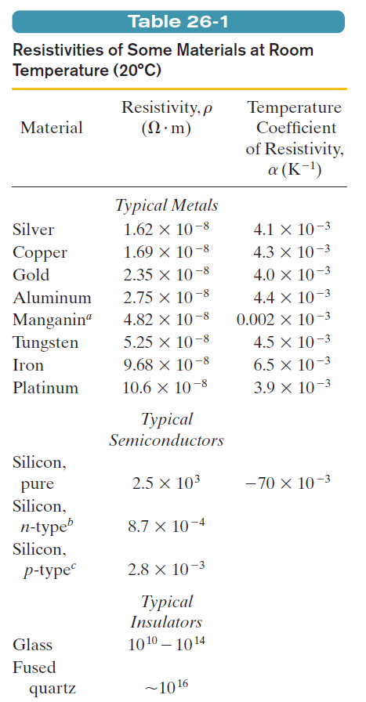

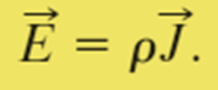

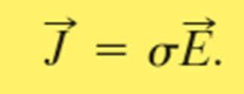
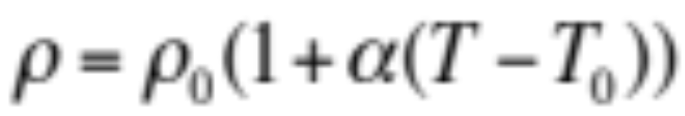
26.4: Resistance and Resistivity:
The resistivity, ρ, of a resistor is defined as:
This is a local property.
The SI unit for ρ is Ω m.
The conductivity σ of a material is the reciprocal of its resistivity:

Slide 5
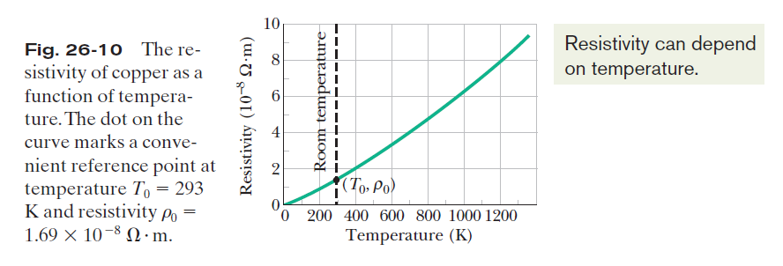
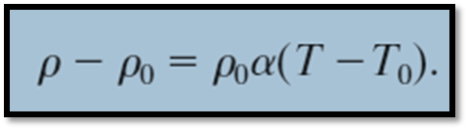
26.4: Resistance and Resistivity, Variation with Temperature:
The relation between temperature and resistivity for copper—and for metals in general—is fairly linear over a rather broad temperature range. For such linear relations we can write an empirical approximation that is good enough for most engineering purposes:

Slide 6
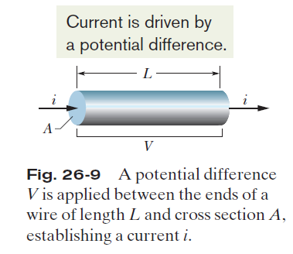



26.4: Resistance and Resistivity, Calculating Resistance from Resistivity:

Slide 7
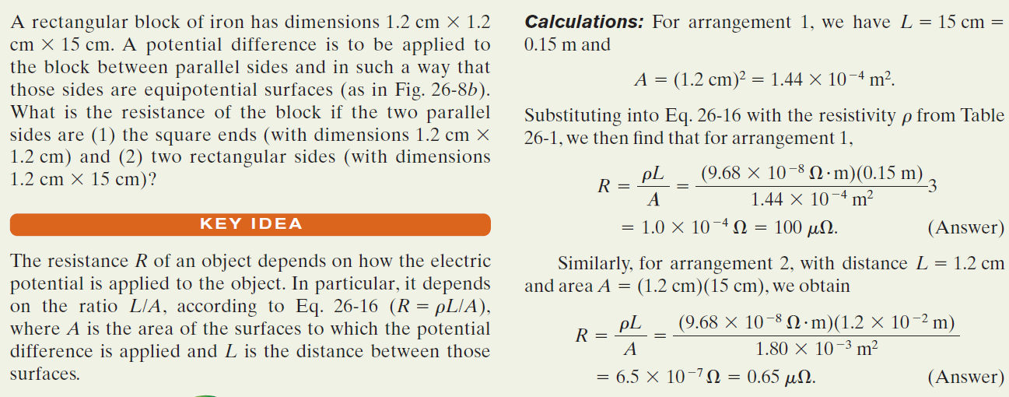
Example, A material has resistivity, a block of the material has a resistance.:

Slide 8

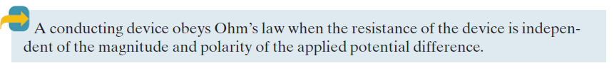
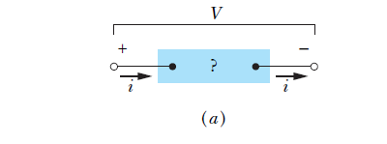
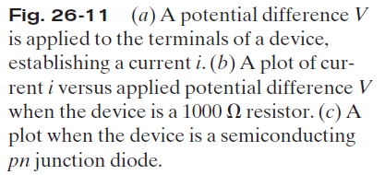
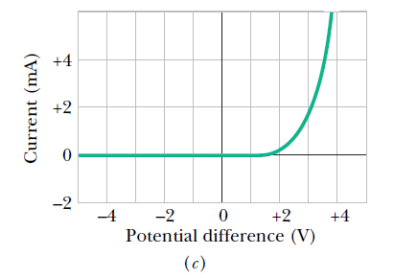
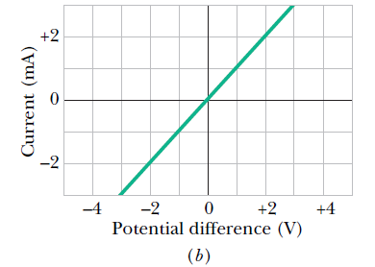
26.5: Ohm’s Law:

Slide 9
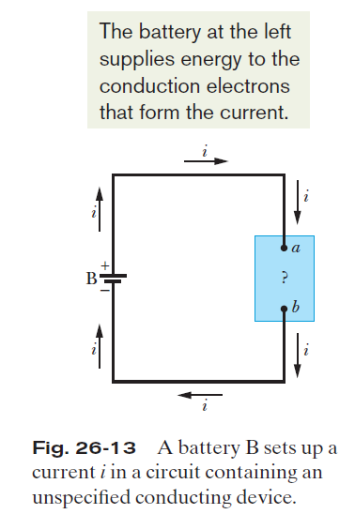





26.7: Power in Electric Circuits:
Charge dq moves through a decrease in potential of
magnitude V, and thus its electric potential energy decreases in magnitude by the amount
The power P associated with that transfer is the rate of transfer dU/dt, given by
The unit of power is the volt-ampere (V A).

Slide 10
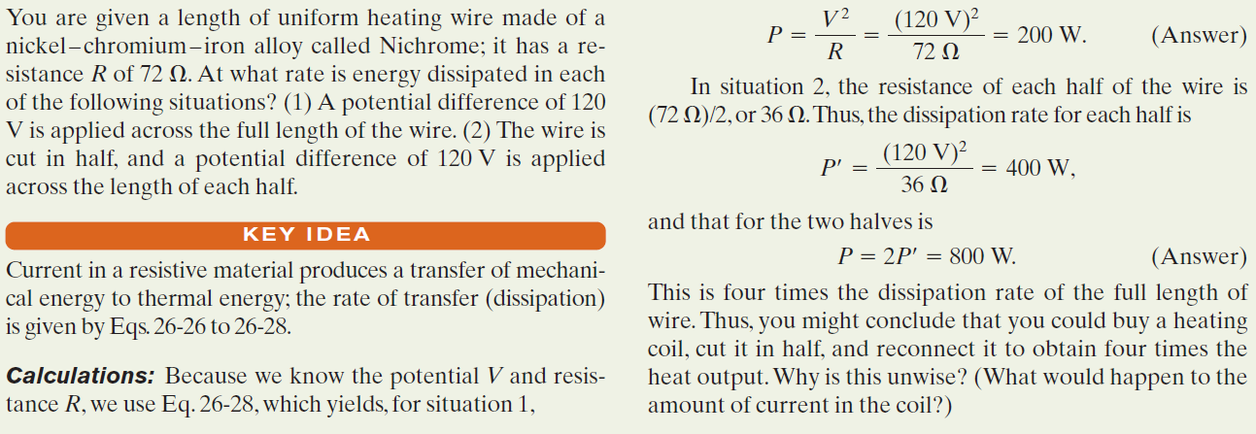
Example, Rate of Energy Dissipation in a Wire Carrying Current:

Slide 11
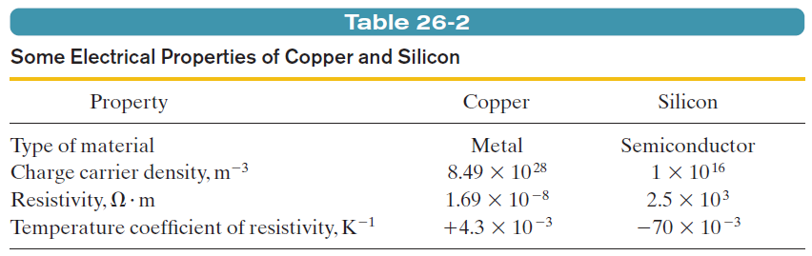

26.8: Semiconductors:
Pure silicon has a high resistivity and it is effectively an insulator. However, its resistivity can be greatly reduced in a controlled way by adding minute amounts of specific “impurity” atoms in a process called doping.
A semiconductor is like an insulator except that the energy required to free some electrons is not quite so great. The process of doping can supply electrons or positive charge carriers that are very loosely held within the material and thus are easy to get moving. Also, by controlling the doping of a semiconductor, one can control the density of charge carriers that are responsible for a current.
The resistivity in a conductor is given by:
In a semiconductor, n is small but increases very rapidly with temperature as the increased thermal agitation makes more charge carriers available. This causes a decrease of resistivity with increasing temperature. The same increase in collision rate that is noted for metals also occurs for semiconductors, but its effect is swamped by the rapid increase in the number of charge carriers.

Slide 12
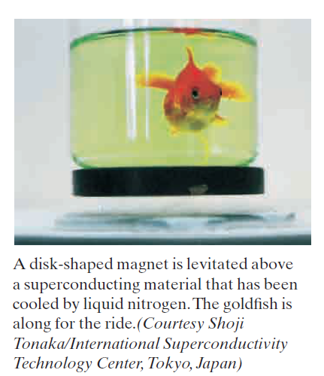
26.9: Superconductors:
In 1911, Dutch physicist Kamerlingh Onnes discovered that the resistivity of mercury absolutely disappears at temperatures below about 4 K .This phenomenon is called superconductivity, and it means that charge can flow through a superconducting conductor without losing its energy to thermal energy.
One explanation for superconductivity is that the electrons that make up the current move in coordinated pairs. One of the electrons in a pair may electrically distort the molecular structure of the superconducting material as it moves through, creating nearby a short-lived concentration of positive charge. The other electron in the pair may then be attracted toward this positive charge. Such coordination between electrons would prevent them from colliding with the molecules of the material and thus would eliminate electrical resistance. New theories appear to be needed for the newer, higher temperature superconductors.

Slide 13
Homework:
Problems 10, 22, 32, 35, 50

